Slide 1
Meeting with CCBE
Strasbourg 8 December 2017

Slide 2
Figures
September 2011: 160,200 apps (101,800 SJ)
December 2015: 64,450
Upward trend in 2016: 23% increase in pending apps
June 2017: 93,000 apps
November 2017: 64,500 apps

Slide 3
Workload
64,500 apps:
24,000 priority cases (including 17,000 conditions of detention apps) Categories I-III
20,000 Chamber/Category IV
15,000 Category V
5,500 Categories VI/VII

Slide 4
Conclusions
Inadmissible cases still under control.
Repetitive cases – after leading / pilot judgment followed by repatriation or WECL without request of observations.
Stock of priority and Category IV Chamber apps (leaving aside conditions of detention cases) remains largely unchanged - 27,000 apps.

Slide 5
New priority policy May 2017

Slide 6
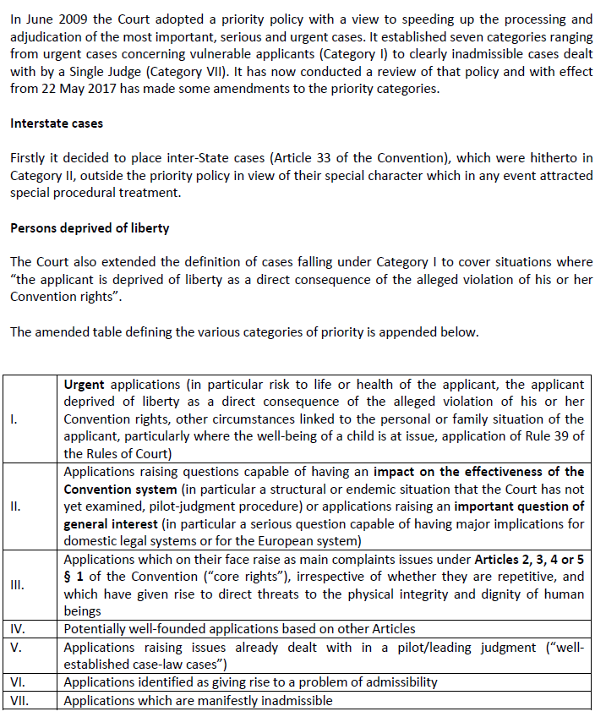

Slide 7
BROADER WECL

Slide 8
Starting points:
Articles 27 and 28 of the Convention define the competence of single judges and committees
while
Article 29 § 1 establishes Chamber competence by default.
ARTICLE 28 Competence of Committees
1. In respect of an application submitted under Article 34, a committee may, by a unanimous vote
…
(b) declare it admissible and render at the same time a judgment on the merits, if the underlying question in the case, concerning the interpretation or the application of the Convention or the Protocols thereto, is already the subject of well-established case-law of the Court.

Slide 9
Broader application of the WECL concept
More than 20,500 judgments delivered
WECL: all cases which can be decided on the basis of existing case-law might be examined by Committes.

Slide 10
Particular types of cases falling under the Broader WECL concept:
(a) PRIORITY cases
(b) cases concerning key Articles of the Convention (2,3 etc.)
(c) factually complex and/or numerous complaints cases
(d) cases communicated by Chamber

Slide 11
When is case-law considered well-established?
The issue at stake has been addressed in one GC, pilot or leading judgment or in a recent Chamber judgment against the State concerned
If not, other criteria should be applied; among these, in principle the Court will have regard to whether the issue (not necessarily identical but relatively similar) has been examined in at least three judgments against OTHER States

Slide 12
Types of cases which will continue to be examined by a Chamber:
(a) cases that may contribute to develop, change or clarify case-law (problem of INTERPRETATION)
(b) cases that may apply existing case-law in a novel factual context (problem of APPLICATION)
(c) borderline cases (or cases NOT “case-law waterproof”)
(d) high profile (applicant’s personality) and/or sensitive cases (media attention) that are of particular importance for the national legal order

Slide 13
PROCEDURAL POINT
Parties:
Are informed at communication stage of the Court’s intention to assign a case to a Committee
have the possibility to object in their observations
No veto, the judges can process the apps in CTE but objections, if any, will be considered

Slide 14
Recap
Single Judge
WECL (no observations requested) repetitive apps
Procedures with request of observations
with statement of facts – CHB/CTE
Without statement of facts IMSI - CHB/CTE
Broader WECL (CTE)
Processing the applications implies a flexible use of several tools, IMSI is one of them

Slide 15
Immediate Simplified communication

Slide 16
12 pays tests en 2016, 12 test countries in 2016
27 Pays / 27 States 30/11/2017
ALB, AUT, AZE, BEL, BGR, BIH, CRO, DNK, ESP, FRA, GER, GRC, HUN, ISL, ITA, LVA, MDA, MKD, MON, NLD, PRT, ROM, RUS, SUI, SVN, TUR, UKR
1 501 requêtes communiquées / applications communicated
(843 avec une irrecevabilité partielle / with partial inadmissibility)
dont 101 déjà décidées /101 of them already decided

Slide 17
Quelles affaires? Which cases ?
requêtes conformes à l’article 47 /Rule 47 type of cases
affaires en arriéré ou nouvelles, simples ou complexes/backlog or new cases, simple or complex
avec l’accord du juge Rapporteur et du juge National/with the approval of the Judge Rapporteur and the National Judge
Pas d’exposé des faits mais l’objet de l’affaire /no statement of facts but a subject matter of the case
Les questions sont plus détaillées / questions are more specific
Procédure plus contradictoire (contester et documenter) / adversarial procedure (contest and document)
Les groupes de requêtes permettent de se demander s’il y a un problème plus général et ont un lien entre elles /Groups of applications might be a good opportunity to see if there is a more general problem and they have a connection

Slide 18
Pas de gain dans l’analyse du dossier/ No saving in analysing the file
Gain de temps lors de la communication / Time is saved at the communication level
des irrecevabilités partielles sont décidées par le président de Section/ partial decisions are taken by the Section President
Gain de temps lors de la préparation des deuxièmes rapports ou des projets d’arrêts. / Time is saved also when drafting the second report or draft judgment.

Slide 20
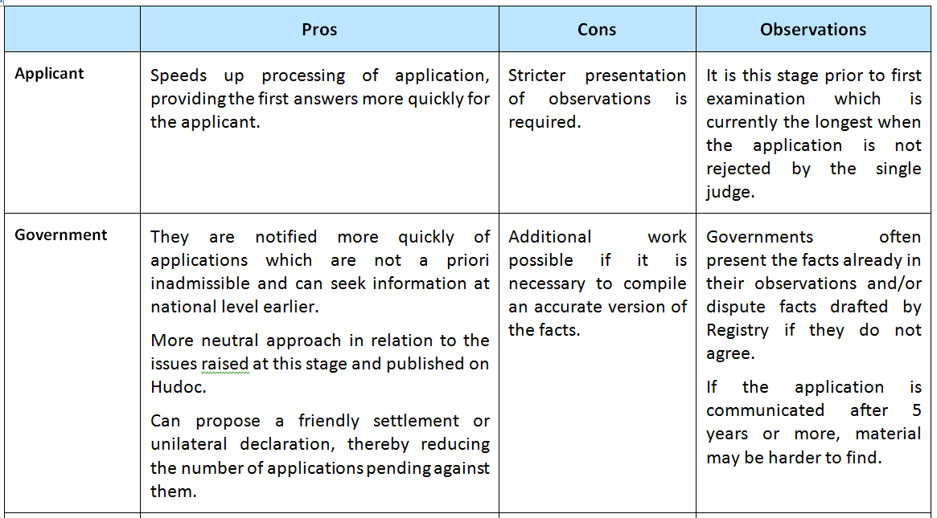

Slide 21
